Slide 1
Deep Learning Lecture 1 – INTRODUCTION

Slide 2
OVERVIEW of Today
Schedule:
Review of last week
A bit more maths (Finish last week)
Optimisation algorithms
Regularisation methods
Software & Hardware
Lab:
Introduction to Tensorflow & Keras

Slide 3


How is At1 going?

Slide 4
OVERVIEW of Today
Schedule:
Review of last week
A bit more (maths) from last week
Optimisation algorithms
Regularisation methods
Software & Hardware
Lab:
Introduction to Tensorflow & Keras

Slide 5
To be perfectly blunt…..
“All the impressive achievements of deep learning amount to just curve fitting” – Judea Pearl

Slide 6
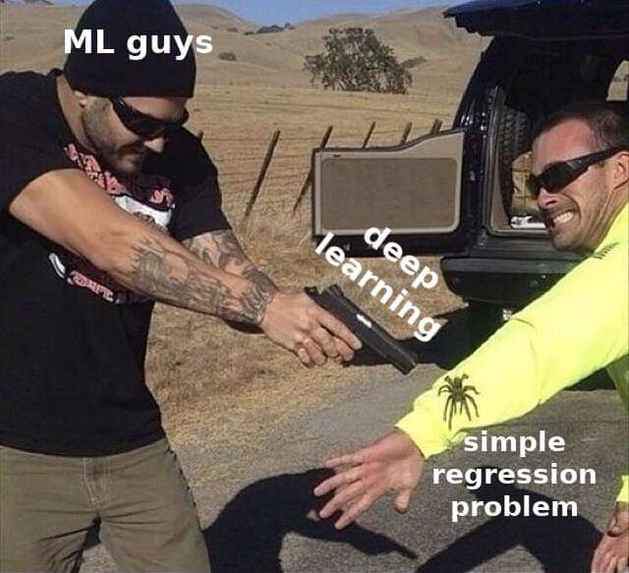
Be careful…

Slide 7
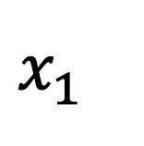
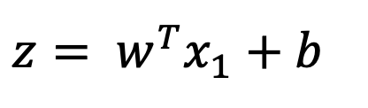
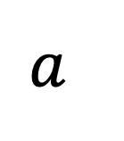
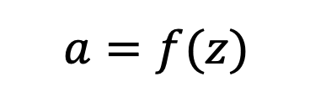
Inside a Neuron
$${z= w}^{T}x_{1}+b$$
$$a=f(z)$$
$$x_{1}$$
$$a$$
Adding function
Non-linear activation function
Why transpose W?

Slide 8
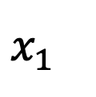
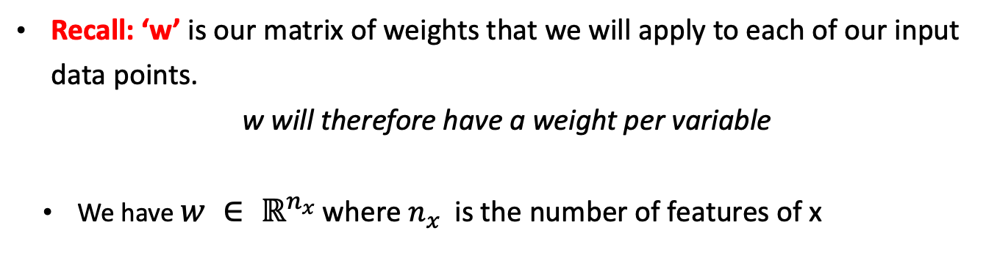
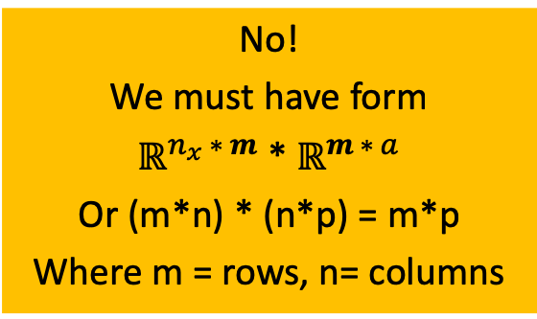
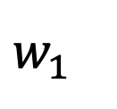
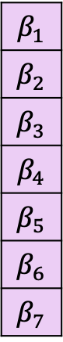
Why transpose W?
Recall: ‘w’ is our matrix of weights that we will apply to each of our input data points.
w will therefore have a weight per variable
We have $w ∈ ℝ^{n_{x} }$where $n_{x}$ is the number of features of x
$$β_{1}$$
$$β_{2}$$
$$β_{3}$$
$$β_{4}$$
$$β_{5}$$
$$β_{6}$$
$$β_{7}$$
Can I multiply these together currently?
Consider 1 training example of 10 features
No! We must have form $ℝ^{n_{x} ∗ m}$ * $ℝ^{m ∗ a}$ Or (m*n) * (n*p) = m*p Where m = rows, n= columns
$$x_{1}$$
$$w_{1}$$

Slide 9
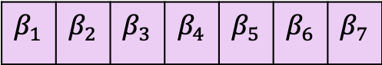
Why transpose W?
To allow us to undertake matrix calculus we must transpose something
$$β_{1}$$ | $$β_{2}$$ | $$β_{3}$$ | $$β_{4}$$ | $$β_{5}$$ | $$β_{6}$$ | $$β_{7}$$
(1*7) * (7*1) = (1*1)
Can I multiply these together currently?
Yes!
Columns(x) = rows(w)

Slide 10
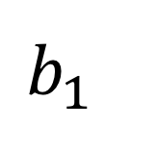
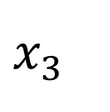
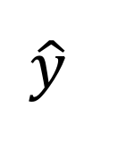
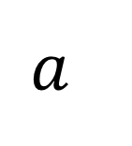
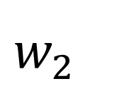
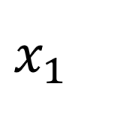
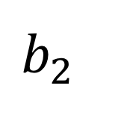
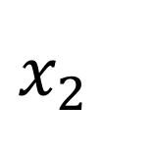
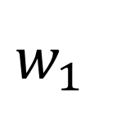
Neuron to ‘network’
$$x_{1}$$
Magic
$$x_{3}$$
Magic
$$a$$
$$\hat{y}$$
$$x_{2}$$
Magic
Input layer
Magic
$$w_{2}$$
$$b_{2}$$
$$w_{1}$$
Output layer
$$b_{1}$$
Hidden layer

Slide 11
Other Activation Functions

Slide 12
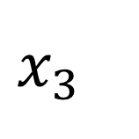
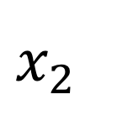
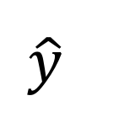
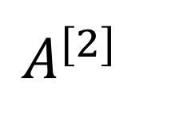
The matrix algebra through our network
$$x_{1}$$
$$x_{2}$$
$$A^{[2]}$$
$$\hat{y}$$
$$x_{3}$$
L2 is a function of L1
Note what are the later layers are modelling?
L1 is a function of L0

Slide 13
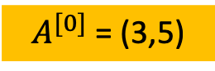
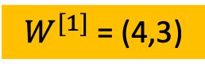
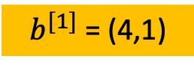
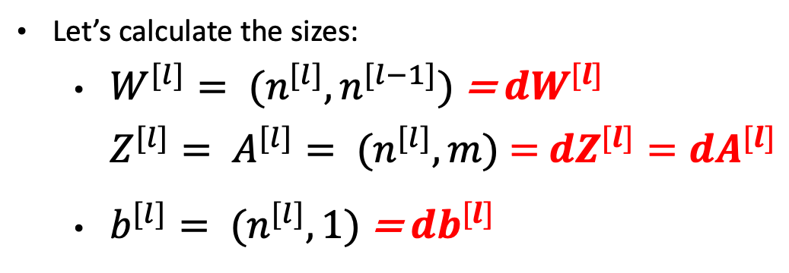
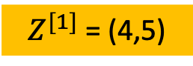
The size of our matrices
$A^{[0]}$ = (3,5)
$Z^{[1]}$ = (4,5)
$b^{[1]}$ = (4,1)
$W^{[1]}$ = (4,3)
Let’s calculate the sizes:
$W^{[l]}= {(n}^{[l]},n^{[l−1]})$ = ${dW}^{[l]}$ $Z^{[l]}= A^{[l]}= {(n}^{[l]}, m)$ $=$ ${dZ}^{[l]}={dA}^{[l]}$
$b^{[l]}= {(n}^{[l]},1)$ = ${db}^{[l]}$

Slide 14

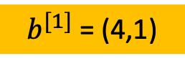
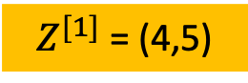
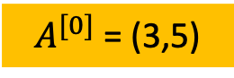
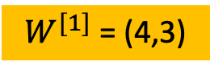
Our matrices (formulas)
=
+
$A^{[0]}$ = (3,5)
$b^{[1]}$ = (4,1)
$Z^{[1]}$ = (4,5)
$W^{[1]}$ = (4,3)
$$Z^{[L]}= W^{[L]}.A^{[L−1]}+b^{[L]}$$

Slide 15
How to ‘A.I’ in (6) simple steps
Initialize your network
Select number of hidden layers, number of hidden units per layer, activation functions
‘Feed Forward’
We have covered this essentially!
Calculate a loss
How bad did our model do?
‘Back propagate’
This will allow us to see how our weights affect our loss
Update weights
Repeat
(Optional – regularize)

Slide 16
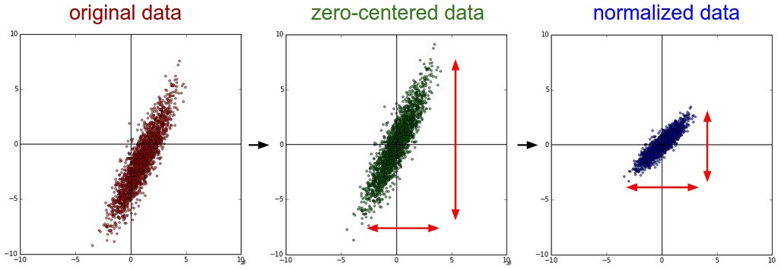
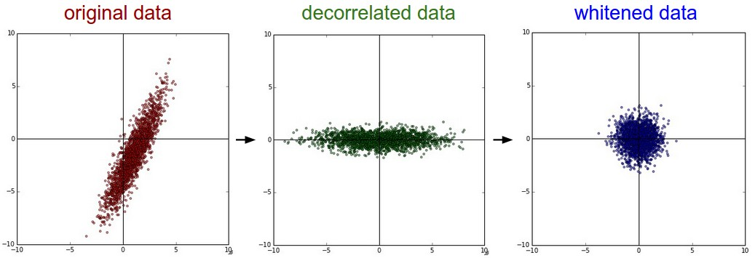
Data Preparation:
zero-center/ zero-mean the data
normalize the data.
Whitening/sphering
zCA whitening

Slide 17
Weight initialization
Proposition 1: Simply initialize the weights to zero?
Bad Idea – Why?
The weights would all do the same thing, output same values, receive same gradient etc.
Proposition 2: Add a small non-zero value
Ok – but has some issues (See AT1)
Proposition 3: Other, advanced methods
(See AT1)

Slide 18
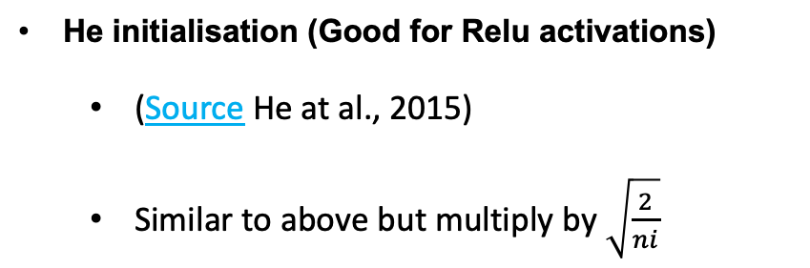
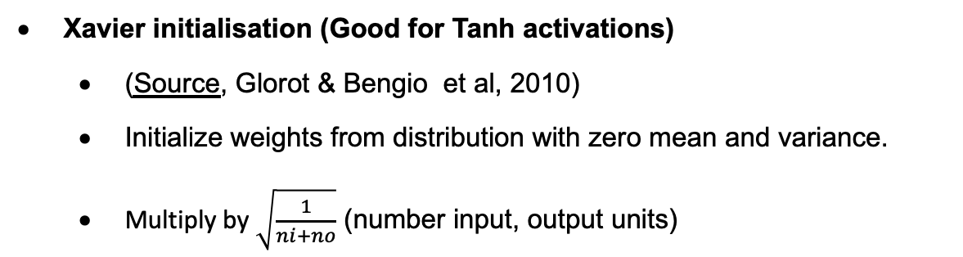
Weight initialization Part 2
Xavier initialisation (Good for Tanh activations)
(Source, Glorot & Bengio et al, 2010)
Initialize weights from distribution with zero mean and variance.
Multiply by $\sqrt{\frac{1}{ni+no}}$ (number input, output units)
He initialisation (Good for Relu activations)
(Source He at al., 2015)
Similar to above but multiply by $\sqrt{\frac{2}{ni}}$

Slide 19

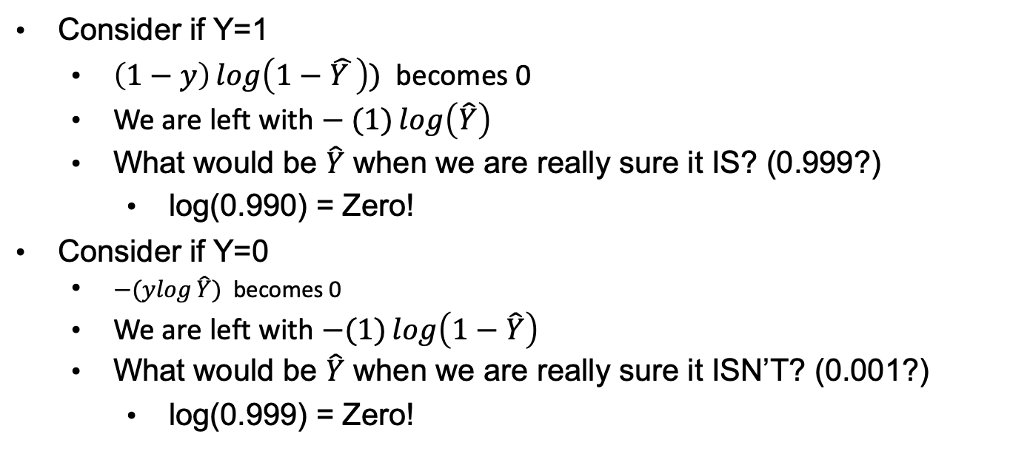
Creating a loss function (cross-entropy)
Let us consider a binary outcome, then we can use a sigmoid loss function
Consider if Y=1
$\left(1−y\right)\log\left(1−\hat{Y }\right))$ becomes 0
We are left with $− (1)\log\left(\hat{Y}\right)$
What would be $\hat{Y}$ when we are really sure it IS? (0.999?)
log(0.990) = Zero!
Consider if Y=0
$−(ylog{\hat{Y})}$ becomes 0
We are left with $−(1)\log\left(1−\hat{Y}\right)$
What would be $\hat{Y}$ when we are really sure it ISN’T? (0.001?)
log(0.999) = Zero!

Slide 20
BACK-PROPAGATION
Once we have decided on a neural network architecture, the model boils down to a set of weights
We cannot use optimisation methods from linear models to determine all these weights. Why?
We use the back-propagation algorithm instead:
Find the error at the output layer (i.e. classification error, MSE)
Use this error to adjust the weight between the last hidden layers and the output layer ➔ we back-propagate the error at the output layer to the hidden layer
Repeat 1 and 2 until all hidden layers are updated

Slide 21
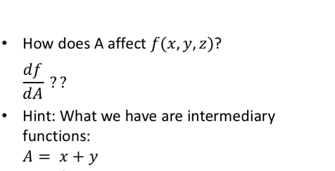
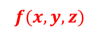
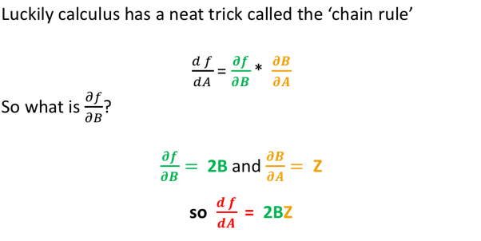
BACK-PROPAGATION
X
+
A
*
^2
Y
B
F
Z

Slide 22
BACK-PROPAGATION for Matrices
What if we don’t have scalars but have matrices?
Everything holds true, except we now get a jacobian matrix (first order partial derivatives of the weight matrices with respect to the loss function)
An example computational graph:
Matrix multiplication (then)
L2 transformation (sum of the square of each element) v

Slide 23
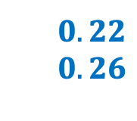
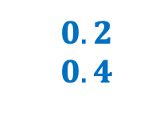
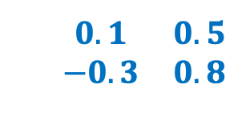
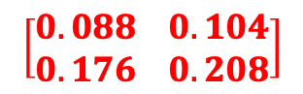
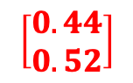
Jacobian walkthrough (backwards)
$$\begin{matrix}0.1 & 0.5 \\ −0.3 & 0.8\end{matrix}$$
W
$$\begin{matrix}0.22 \\ 0.26\end{matrix}$$
$$\left[\begin{matrix}0.088 \\ 0.176\end{matrix} \begin{matrix}0.104 \\ 0.208\end{matrix}\right]$$
*
L2
0.116
Q
F
f(x,W)
$$\begin{matrix}0.2 \\ 0.4\end{matrix}$$
x
$$\left[\begin{matrix}0.44 \\ 0.52\end{matrix}\right]$$
1.00
Key takeaway:
The fundamental principle of the ‘Chain Rule’ can be applied to matrices in order to determine the influence of weight matrix elements on final output (loss)

Slide 24
Updating the weights - Gradient descent
In multiple dimensions, the gradient is the vector of partial derivatives along each dimension.
Think of it like a person standing somewhere in a valley of lots of ups and downs. Your goal is to find the lowest point (and efficiently!)
The height is the loss function, X-Y-Z are your parameters
(do we have only 3 parameters? How many do we have?)
Start somewhere
Take a bunch of little steps around us and see where is the steepest slope (negative derivative)
Then take a small step in that direction
Repeat

Slide 25
Updating the weights - Gradient descent
The small step is termed the learning rate:
If α is too small, gradient descent will take a long time
If α is too large, you can fail to converge or overshoot the minimum (diverge)
https://www.youtube.com/watch?v=WnqQrPNYz5Q
https://www.youtube.com/watch?v=IHZwWFHWa-w

Slide 26
Gradient descent

Slide 27
OVERVIEW of Today
Schedule:
Review of last week
A bit more (maths) from last week
Optimisation algorithms
Regularisation methods
Software & Hardware
Lab:
Introduction to Tensorflow & Keras

Slide 28
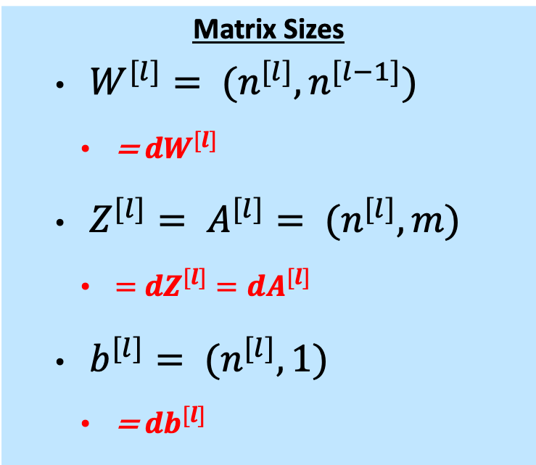
Forward prop (summary)
Matrix Sizes
$W^{[l]}= {(n}^{[l]},n^{[l−1]})$
= ${dW}^{[l]}$
$Z^{[l]}= A^{[l]}= {(n}^{[l]}, m)$
$=$ ${dZ}^{[l]}={dA}^{[l]}$
$b^{[l]}= {(n}^{[l]},1)$
= ${db}^{[l]}$
For the first and second layers:
For some layer l:

Slide 29
Back prop MathS
(1/m) *
Let’s go backwards on this computational graph
Differentiate loss w.r.t a^{[2]}
Differentiate loss w.r.t z^{[2]}

Slide 30
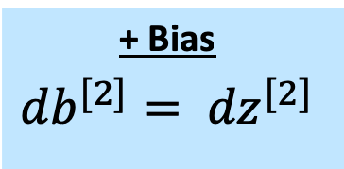
Back prop MathS
Differentiate loss w.r.t a^{[2]}
Differentiate loss w.r.t z^{[2]}
Differentiate loss w.r.t w^{[2]}
+ Bias
$${db}^{[2]}= {dz}^{[2]}$$

Slide 31
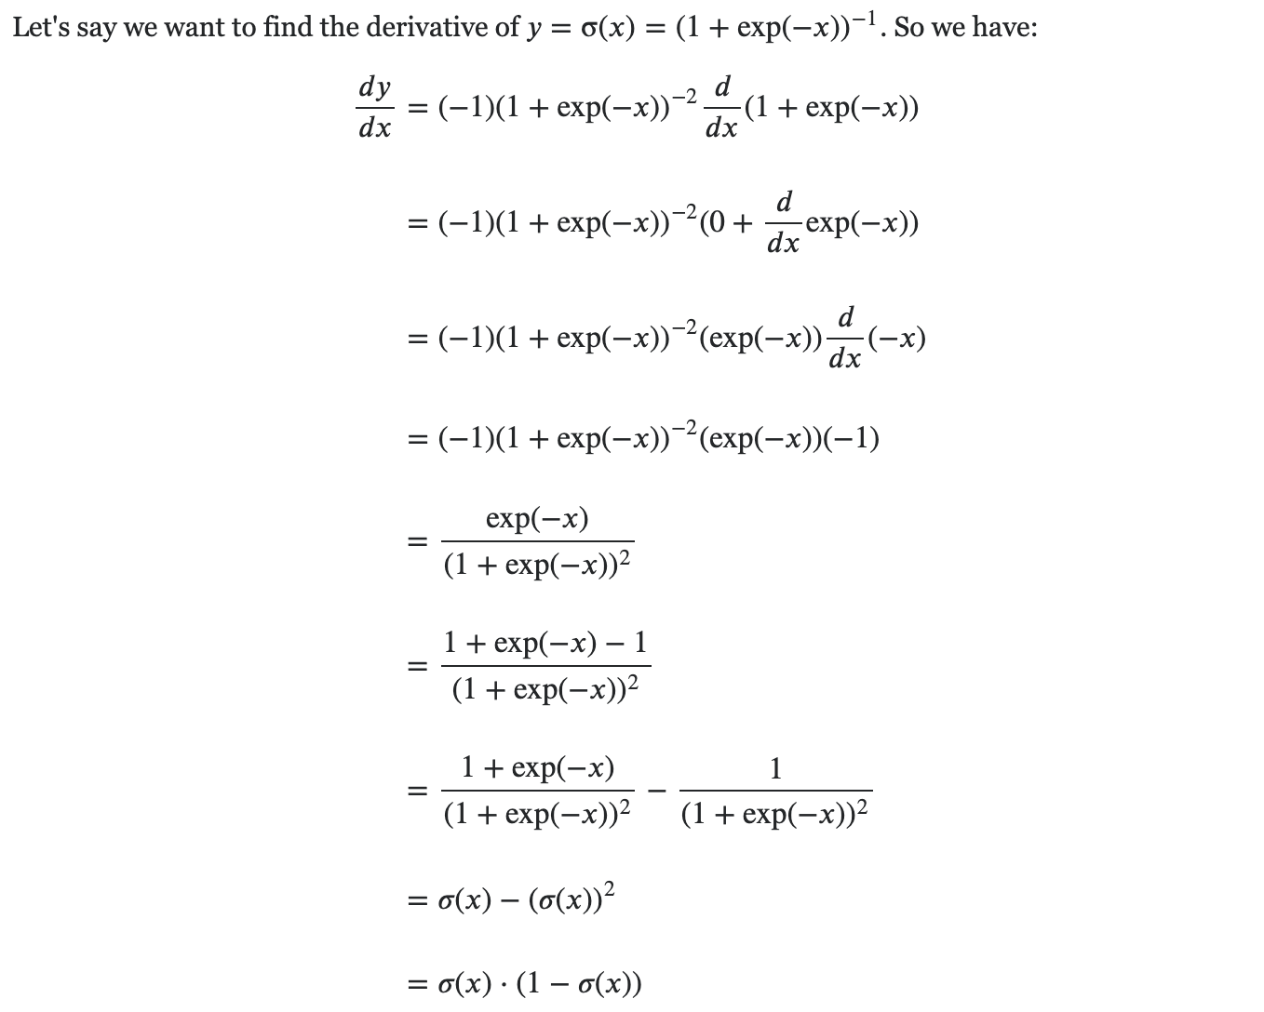
Differentiate Sigmoid
https://towardsdatascience.com/derivative-of-the-sigmoid-function-536880cf918e
https://math.stackexchange.com/questions/78575/derivative-of-sigmoid-function-sigma-x-frac11e-x

Slide 32
Cont…..
Back to our data:

Slide 33
Let’s Vectorise!

Slide 34
Let’s Generalise!

Slide 35
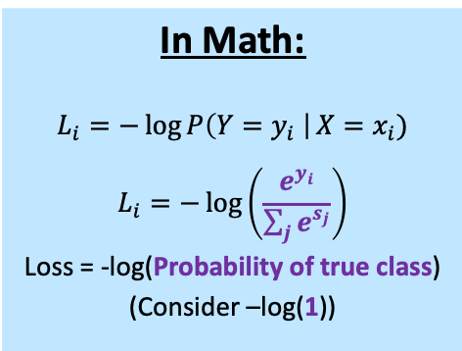
Loss functions – Softmax
What if we have multiple classes? Introducing Softmax function
Probability Y is some class (given the network) is equal to e-to-the-power of the ‘score’ for that class divided by the sum of each other ‘score’ to the other classes, raised by e
We are essentially computing a probability distribution over our classes
Therefore the loss can be seen as the negative log likelihood of the correct class
In Math:
$$L_{i}=−\log{P\left(Y=y_{i} \right|}X=x_{i}) \\ L_{i}=−\log\left(\frac{e^{y_{i}}}{\sum_{j}{e^{s_{j}}}}\right)$$
Loss = -log(Probability of true class)
(Consider –log(1))

Slide 36



Loss functions – Softmax
Probability Y is some class (given the network) is equal to e-to-the-power of the ‘score’ for that class divided by the sum of each other ‘score’ to the other classes, raised by e
'Score’
3.2
5.1
-1.7
Raise e
24.5
164.0
0.18
Divide
0.13
0.87
0.00095
Loss
0.89
0.06
6.96
$$e^{3.2}=24.5$$
$$\frac{24.5}{(24.5+164+0.18)}=0.13$$
$$−log⁡(0.13)=0.89$$

Slide 37
What do these numbers mean?
Consider asking the network (you) to place a 'bet' on which class it will be. It can bet any amount and then the loss is how much you lose from that bet if it turns out that that corresponding row is the correct class. Obviously you want to lose less. Now on the slide consider;
IF the top row was the correct class. You lose 0.89 because you actually bet more on the middle row.
IF the middle class was the correct class, you only lose 0.06 On the middle row you bet the most on that row.
IF the bottom row was the correct class, you made a negative bet so you were really really really sure it was NOT the correct class when in fact it was. So you get a huge loss.
'Score’
3.2
5.1
-1.7
Raise e
24.5
164.0
0.18
Divide
0.13
0.87
0.00095
Loss
0.89
0.06
6.96

Slide 38
Loss functions – Other
Hinge loss (Multi-class SVM)
Regression (MSE, MAE, RMSE)
Others
https://towardsdatascience.com/common-loss-functions-in-machine-learning-46af0ffc4d23

Slide 39
OVERVIEW of Today
Schedule:
Review of last week
A bit more (maths) from last week
Optimisation algorithms
Regularisation methods
Software & Hardware
Lab:
Introduction to Tensorflow & Keras

Slide 40

Optimisation: (Mini)batch, Stochastic GD
The problem: If we have many training examples, our input matrix becomes huge!
Consider X where we have 5 or 10 or 15 million examples….
A solution is to undertake minibatch gradient descent, so splitting our dataset into size of 256 samples, our cost function becomes:
$J^{\{t\}}\left(w,b\right) = \frac{1}{256}\sum_{i=1}^{256}{L\left(\hat{Y^{\left(i\right)},}y^{\left(i\right)}\right)}$
Where {t} is our minibatch
Simply loop through all minibatches, forward-backprop as normal
One round (minibatch) is considered an epoch

Slide 41

Optimisation: (Mini)batch, Stochastic GD
If you have:
minibatch size is m then you have batch gradient descent. This can take huge processing power, though will step and converge nicely.
Minibatch size is 1 then you have stochastic gradient descent. You lose the vectorisation speedup and is quite noisy.
If minibatch size is >1<m then you have minibatch gradient descent
Common minibatch sizes are 64, 128, 256, 512
Technically also a hyperparameter (though not a primary one)

Slide 42

Optimisation Algorithms: Momentum
Consider the formula for and exponentially weighted moving averages:
$V_{t}= β V_{t−1}+(1−β)x_{t}$ where $β ∈[0,1]$ and $x_{t}$is some value at the current time.
We can approximate that $V_{t}$is averaging over $\frac{1}{1−β}$days
We are computing an average that takes into account n number of trailing days. Consider 0.9 for $β$
$V_{100}$ = ${0.9V}_{99}+ {(1−0.9) x}_{100}$
$V_{99}$ itself =${0.9V}_{98}$ and ${(1−0.9)x}_{99}$ etc
Therefore $V_{100}$ is a small weight ${(0.1) x}_{100}$ of the current value and a sum of all previous temperatures
multiplied by an exponentially decaying function
So ${0.1x}_{100}+0.1∗0.9x_{99}+ 0.1∗{(0.9)}^{2}x_{98}$…etc

Slide 43

Optimisation Algorithms: Momentum
(From source)
Adjust $β$ to be lower, you get a more noisy graph as you let local effects be more powerful.
Larger $β$ smooths more but will respond slower.

Slide 44

Optimisation Algorithms: Momentum
How does this work for us?
Initialise $V_{dW}, V_{db}=0$ where $V_{dW}$ is the same dimensions as $W$ and $V_{db}$ has same dimensions as b
On iteration t:
Compute $dW$, $db$ as usual on the current mini-batch
$V_{dW}= β V_{dW}+\left(1−β\right)dW$
$V_{db}= β V_{db}+\left(1−β\right)db$
Update:
$W≔ W− α∗V_{dW}$
$b≔ b− α∗V_{db}$
An extension to this (nesterov momentum) does a ‘step forward backwards’ alteration (often oversteps)
Best 𝛽?
Commonly 0.9 is used (‘Averaging over the last 10 gradients’ 𝛽) but perhaps try others?

Slide 45
Optimisation Algorithms: Nesterov
An extension to momentum does a ‘step forward backwards’ alteration (often oversteps) (source in notes)
Rather than taking a weighted average of Velocity and Gradient (at current point) to make our actual step, we instead:
Step in direction of velocity
Take gradient at that point
Go back to original point and mix together these two for the actual step.
Notes:
Yurii Nesterov. A method of solving a convex programming problem with convergence rate O(1/k 2 ). In Soviet Mathematics Doklady, volume 27, pages 372–376, 1983.

Slide 46


Optimisation Algorithms: RMSProp
Source (Hinton on coursera…)
Stands for ‘Root Mean Squared’ Prop
Initialise $S_{dW}, S_{db}=0$
On iteration t:
Compute $dW$, $db$ as usual on the current mini-batch
$S_{dW}= β S_{dW}+(1−β)dW^{2}$
$S_{db}= β S_{db}+(1−β)db^{2}$
Update:
$W≔ W− α∗\frac{dW}{\sqrt{S_{dW}+ ε}}$
$b≔ b− α∗\frac{db}{\sqrt{S_{db}+ ε}}$
Why?
This keeps a moving average of the squared gradient of each weight. This should ‘squash’ high oscillating training run.
Notes:
Note the element-wise square on our matrices. The small epsilon is something like 1*10^-8 so we don’t accidentally divide by zero.

Slide 47


Optimisation Algorithms: ADAM
‘Adaptive Moment Estimation’ (Momentum + RMSProp)
$β_{m}$ (momentum 𝛽) as first ‘moment’ and $β_{r}$ (rmsprop 𝛽) as second ‘moment’
Initialise $S_{dW}, S_{db}, V_{dW}, V_{db}=0$
On iteration t:
Compute $dW$, $db$ as usual on the current mini-batch
$V_{dW}= β_{m} V_{dW}+\left(1−β_{m}\right)dW \& V_{db}= β_{m} V_{db}+(1−β_{m})db$
Add a bias correction ${V_{dW}}^{c}$ =$\frac{V_{dW}}{1−{β_{m}}^{t}}$ & ${V_{db}}^{c}$ =$\frac{V_{db}}{1−{β_{m}}^{t}}$
$S_{dW}= β_{r} S_{dW}+(1−β_{r})dW^{2}\text{ \& }S_{db}= β_{r} S_{db}+(1−β_{r})db^{2}$
Add a bias correction ${S_{dW}}^{c}$ =$\frac{S_{dW}}{1−{β_{r}}^{t}}$ & ${S_{db}}^{c}$ =$\frac{S_{db}}{1−{β_{r}}^{t}}$
$\text{Update}\text{: }$
$W≔ W− α∗\frac{{V_{dW}}^{c}}{\sqrt{{S_{dW}}^{c}+ ε}}$
$b≔ b− α∗\frac{{V_{db}}^{c}}{\sqrt{{S_{db}}^{c}+ ε}}$
Commonly:
$β_{m}$ = 0.9
$β_{r}$ = 0.999
$α$ (start) 1e-3 or 5e-4
Why bias correct?
Moments are biased towards zero during initial time steps (especially with small 𝛽)

Slide 48

Optimisation Algorithms: More??
‘Nesterov-accelerated Adaptive Moment Estimation’ (Nesterov momentum + Adam) (source) (NADAM)
Even more????
https://arxiv.org/pdf/1609.04747.pdf
Adagrad, Adadelta, Adamax, AMSGrad

Slide 49
OVERVIEW of Today
Schedule:
Review of last week
A bit more (maths) from last week
Optimisation algorithms
Regularisation methods
Software & Hardware
Lab:
Introduction to Tensorflow & Keras

Slide 50
Regularisation: L2 (Weight Decay)
L2 regularization can be used in neural networks as well. We add a small penalty term to our loss function which becomes a hyperparameter to tune.
That is, for each weight matrix in the NN we simply add the square of each element in those matrices.
Note the F rather than 2 since this is called the Frobenius Norm rather than L2 norm for matrices.
This ‘zeros out’ some hidden units with smaller weights

Slide 51
Regularisation: L2 & Back Prop
We will need to adjust our backprop formulas slightly:
See how we are ‘decaying’ the weight matrix?

Slide 52

Regularisation: Dropout
(Source, Srivastava et al, 2014) Or (Source Hinton, Srivastava et all 2012) Or (Source Farley, Goodfellow et al 2014)
We will need to adjust our backprop formulas slightly:
On each forward pass (Training example), randomly set some neurons to zero So remove all the ingoing and outgoing links to that node
The probability of dropping is a hyperparameter, p
You could also set this differently depending on the layer. So perhaps your last 1 or 2 layers don’t need dropout if they are (n=2) or (n=3) but for more dense layers in the middle you set a higher p.

Slide 53

Regularisation: Dropout

Slide 54

Regularisation: Dropout
Why does it work?
Forces the network to have redundant representation
Can theoretically show it is a version of L2
A Problem:
Our output is random and may take longer to train.
A Solution (‘Inverted Dropout’):
At training time, divide by P so that at test time there is no difference.
For example, if we have a 50 unit layer and drop (0.2 = 10 units), we scale the output (A) by (A/0.8)
Some nice code here
There is also ‘DropConnect’ (a generalization of dropout where you zero out some of the weight matrix)

Slide 55

Extra: Learning Rate Decay
This technique can speed up training and prevent the ‘bounce’ around as the model converges towards an optimum.
We can thus implement standard learning rate decay as follows:
$$α= \frac{1}{1+d ∗ n}∗ α_{0}$$
Where d is the decay rate and n is the epoch number
Other variations:
Exponential decay: $α= {0.95}^{n}∗ α_{0}$
K decay: $α= \frac{k}{\sqrt{n}}∗ α_{0}$ OR $α= \frac{k}{t}∗ α_{0}$ where t is minibatch number
Discrete (‘staircase’/ ‘half-life’) decay = half α at certain t’s
Manual

Slide 56
OVERVIEW of Today
Schedule:
Review of last week
A bit more (maths) from last week
Optimisation algorithms
Regularisation methods
Software & Hardware
Lab:
Introduction to Tensorflow & Keras

Slide 57

GPU - CPU – TPU?
CPUs are a few very complex cores (General processing core)
GPUs are hundreds/thousands of simpler cores (can run thousands of concurrent threads)
Uses parallel processing of the matrix work in NN
(NVIDIA GPU required for CUDA)
TPU is a special custom build by Google specifically for deep learning.

Slide 58

GPU - CPU – TPU?
http://cs231n.stanford.edu/slides/2017/cs231n_2017_lecture8.pdf

Slide 59

What’s in a Framework?
Tensorflow the most popular and has all the bells and whistles
Keras is ‘syntactic sugar’ (a wrapper) for tensorflow.
Caffe2 not used as much (from facebook)
Pytorch recently becoming more popular. Very fast.
Others (not as popular):
CNTK (Microsoft), MXNet (Amazon)
https://www.youtube.com/watch?v=SJldOOs4vB8

Slide 60
Lab – Tensorflow & Keras

